Slide 1
Vector Mechanics For Engineers: Dynamics Twelfth Edition
Copyright © 2020 McGraw Hill , All Rights Reserved.
PROPRIETARY MATERIAL © 2020 The McGraw Hill Inc. All rights reserved. No part of this PowerPoint slide may be displayed, reproduced or distributed in any form or by any means, without the prior written permission of the publisher, or used beyond the limited distribution to teachers and educators permitted by McGraw Hill for their individual course preparation. If you are a student using this PowerPoint slide, you are using it without permission.

Slide 2

Chapter 19
Mechanical Vibrations

Slide 3
Contents
Introduction
Simple Harmonic Motion and Free Vibrations of Particles
Simple Pendulum (Approximate Solution)
Simple Pendulum (Exact Solution)
Sample Problem 19.1
Free Vibrations of Rigid Bodies
Sample Problem 19.2
Sample Problem 19.3
Applying the Principle of Conservation of Energy
Sample Problem 19.4
Forced Vibrations
Sample Problem 19.5
Damped Free Vibrations
Damped Forced Vibrations
Electrical Analogues

Slide 4
Introduction 1
Mechanical vibration is the motion of a particle or body which oscillates about a position of equilibrium. Most vibrations in machines and structures are undesirable due to increased stresses and energy losses.
Time interval required for a system to complete a full cycle of the motion is the period of the vibration.
Number of cycles per unit time defines the frequency of the vibrations.
Maximum displacement of the system from the equilibrium position is the amplitude of the vibration.
When the motion is maintained by the restoring forces only, the vibration is described as free vibration. When a periodic force is applied to the system, the motion is described as forced vibration.
When the frictional dissipation of energy is neglected, the motion is said to be undamped. Actually, all vibrations are damped to some degree.

Slide 5
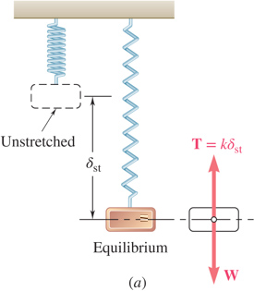
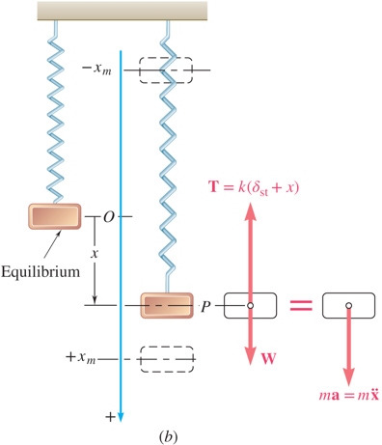
Simple Harmonic Motion and Free Vibrations of Particles 1
If a particle is displaced through a distance x_{m} from its equilibrium position and released with no velocity, the particle will undergo simple harmonic motion,
General solution is the sum of two particular solutions,
x is a periodic function and ω_{n} is the natural circular frequency of the motion.
C₁ and C₂ are determined by the initial conditions:

Slide 6
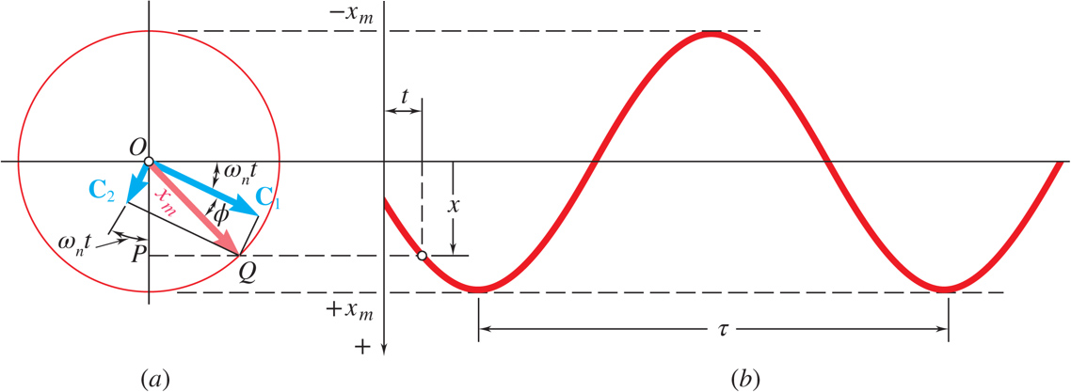
Simple Harmonic Motion and Free Vibrations of Particles 2
amplitude
phase angle
period
natural frequency

Slide 7
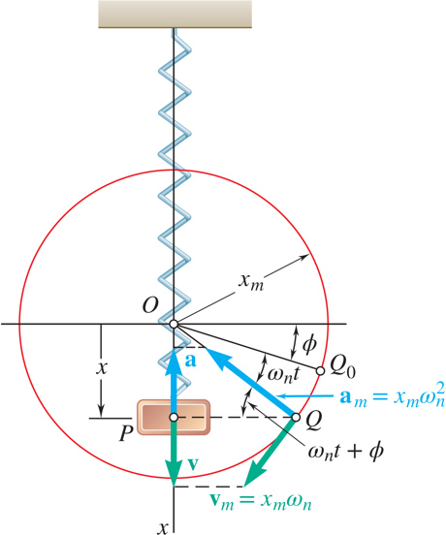
Simple Harmonic Motion and Free Vibrations of Particles 3
Velocity-time and acceleration-time curves can be represented by sine curves of the same period as the displacement-time curve but different phase angles.

Slide 8
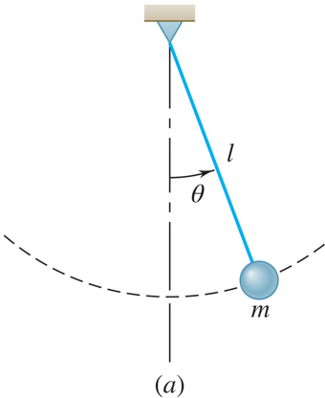
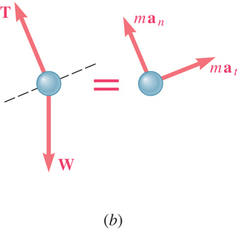
Simple Pendulum (Approximate Solution)
Results obtained for the spring-mass system can be applied whenever the resultant force on a particle is proportional to the displacement and directed towards the equilibrium position.
Consider tangential components of acceleration and force for a simple pendulum,
for small angles,

Slide 9
Simple Pendulum (Exact Solution)
An exact solution for
leads to
which requires numerical solution.
Table 19.1
Correction Factor for the Period of a Simple pendulum
θ_{m} | 0° | 10° | 20° | 30° | 60° | 90° | 120° | 150° | 180°
K | 1.571 | 1.574 | 1.583 | 1.598 | 1.686 | 1.854 | 2.157 | 2.768 | ∞
 | 1.000 | 1.002 | 1.008 | 1.017 | 1.073 | 1.180 | 1.373 | 1.762 | ∞

Slide 10
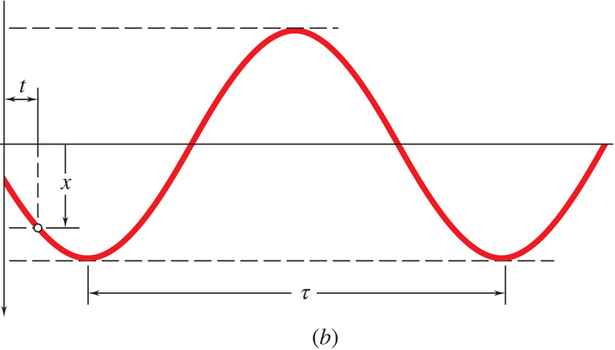
Concept Question 1
The amplitude of a vibrating system is shown to the right. Which of the following statements is true (choose one)?
a) The amplitude of the acceleration equals the amplitude of the displacement
b) The amplitude of the velocity is always opposite (negative to) the amplitude of the displacement
c) The maximum displacement occurs when the acceleration amplitude is a minimum
d) The phase angle of the vibration shown is zero

Slide 11
Concept Question 2
The amplitude of a vibrating system is shown to the right. Which of the following statements is true (choose one)?
a) The amplitude of the acceleration equals the amplitude of the displacement
b) The amplitude of the velocity is always opposite (negative to) the amplitude of the displacement
c) Answer: The maximum displacement occurs when the acceleration amplitude is a minimum
d) The phase angle of the vibration shown is zero

Slide 12
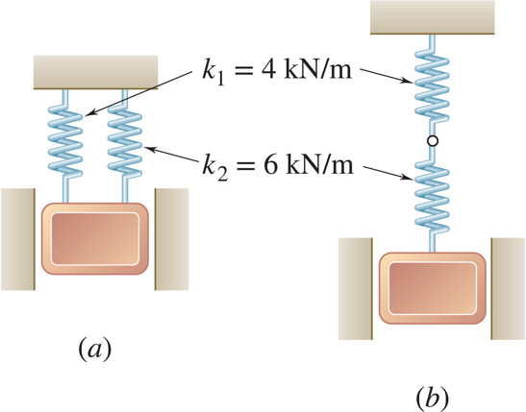
Sample Problem 19.1 1
Strategy:
For each spring arrangement, determine the spring constant for a single equivalent spring.
Apply the approximate relations for the harmonic motion of a spring-mass system.
A 50-kg block moves between vertical guides as shown. The block is pulled 40mm down from its equilibrium position and released.
For each spring arrangement, determine a) the period of the vibration, b) the maximum velocity of the block, and c) the maximum acceleration of the block.

Slide 13
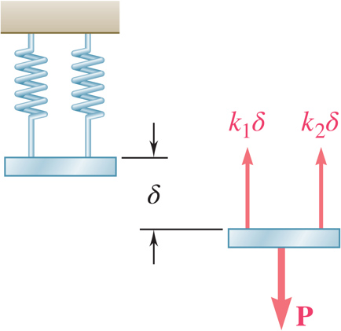
Sample Problem 19.1 2
Modeling and Analysis:
Springs in parallel:
Determine the spring constant for equivalent spring.
Apply the approximate relations for the harmonic motion of a spring-mass system.

Slide 14
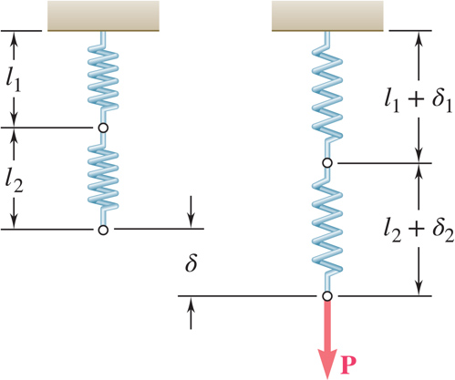
Sample Problem 19.1 3
Springs in series:
Determine the spring constant for equivalent spring.
Apply the approximate relations for the harmonic motion of a spring-mass system.

Slide 15
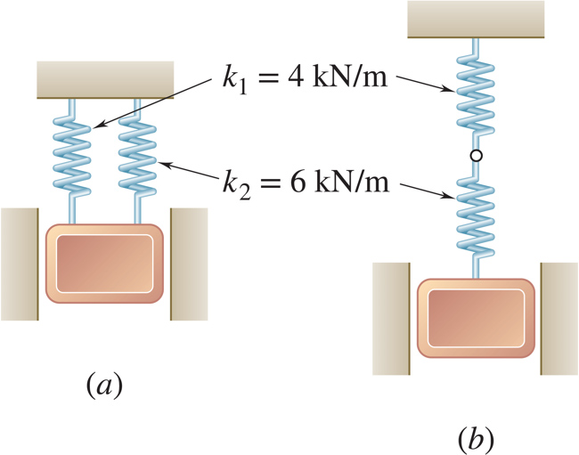
Sample Problem 19.1 4
Reflect and Think:
The problem did not ask you to determine the expression for combining springs in series, but from this analysis,
it is clear that
Thus, for springs in series
and for springs in parallel,

Slide 16
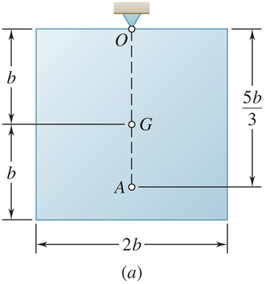
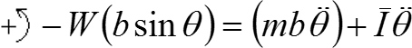
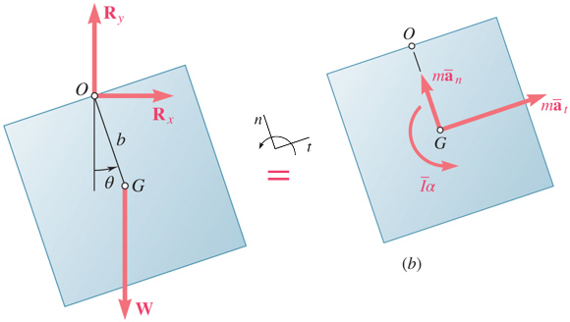
Free Vibrations of Rigid Bodies
If an equation of motion takes the form,
the corresponding motion may be considered as simple harmonic motion.
Analysis objective is to determine
Consider the oscillations of a square plate,
For an equivalent simple pendulum,

Slide 17
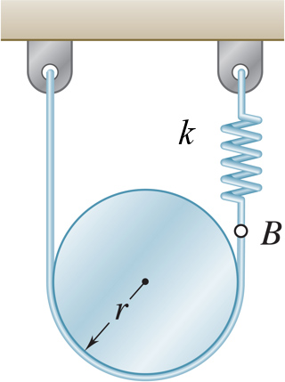
Sample Problem 19.2 1
Strategy:
From the kinematics of the system, relate the linear displacement and acceleration to the rotation of the cylinder.
Based on a free-body-diagram equation for the equivalence of the external and effective forces, write the equation of motion.
A cylinder of weight W is suspended as shown.
Determine the period and natural frequency of vibrations of the cylinder.
Substitute the kinematic relations to arrive at an equation involving only the angular displacement and acceleration.

Slide 18
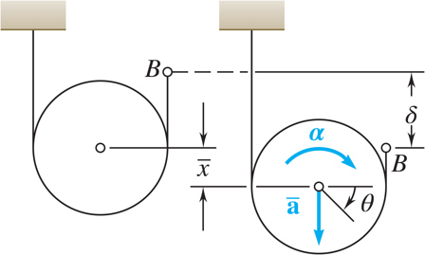
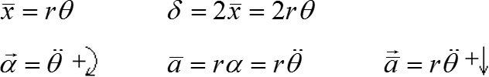
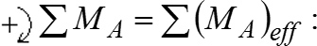
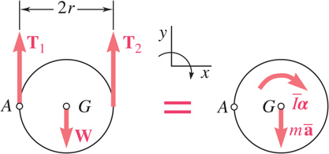
Sample Problem 19.2 2
Modeling and Analysis:
From the kinematics of the system, relate the linear displacement and acceleration to the rotation of the cylinder.
Based on a free-body-diagram equation for the equivalence of the external and effective forces, write the equation of motion.
Substitute the kinematic relations to arrive at an equation involving only the angular displacement and acceleration.

Slide 19
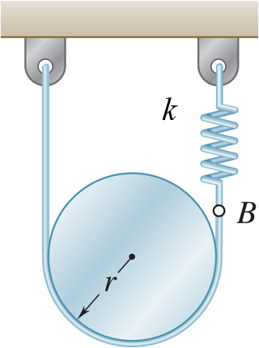
Sample Problem 19.2 3
Reflect and Think:
If the cylinder had been smooth, it would not have rotated when displaced downward. Also note that the answers you obtained are independent of r.

Slide 20
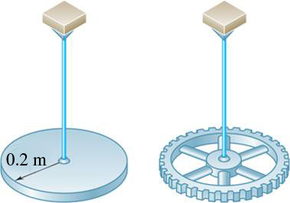
Sample Problem 19.3 1
Strategy:
Using the free-body-diagram equation for the equivalence of the external and effective moments, write the equation of motion for the disk/gear and wire.
With the natural frequency and moment of inertia for the disk known, calculate the torsional spring constant.
The disk and gear undergo torsional vibration with the periods shown. Assume that the moment exerted by the wire is proportional to the twist angle.
Determine a) the wire torsional spring constant, b) the centroidal moment of inertia of the gear, and c) the maximum angular velocity of the gear if rotated through 90º and released.
With natural frequency and spring constant known, calculate the moment of inertia for the gear.
Apply the relations for simple harmonic motion to calculate the maximum gear velocity.

Slide 21

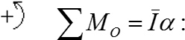
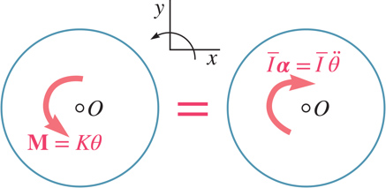
Sample Problem 19.3 2
Modeling and Analysis:
Using the free-body-diagram equation for the equivalence of the external and effective moments, write the equation of motion for the disk/gear and wire.
With the natural frequency and moment of inertia for the disk known, calculate the torsional spring constant.

Slide 22
Sample Problem 19.3 3
With natural frequency and spring constant known, calculate the moment of inertia for the gear.
Apply the relations for simple harmonic motion to calculate the maximum gear velocity.

Slide 23
Sample Problem 19.3 4
Reflect and Think:
A torsional spring is often used experimentally to measure the mass moment of inertia of different objects.
It is common engineering practice to use one situation to determine the dynamic characteristics of a system and then to use those parameters to analyze a slightly different situation.

Slide 24
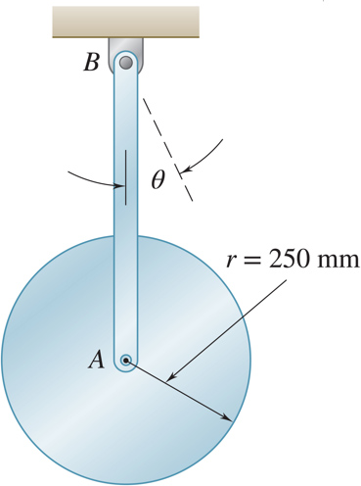
Group Problem Solving 1
Strategy:
Using the free-body and kinetic diagrams, write the equation of motion for the pendulum.
Determine the natural frequency and moment of inertia for the disk (use the small angle approximation).
Calculate the period.
A uniform disk of radius 250 mm is attached at A to a 650-mm rod AB of negligible mass which can rotate freely in a vertical plane about B. If the rod is
displaced
from the position shown
and released, determine the period of the resulting oscillation.

Slide 25
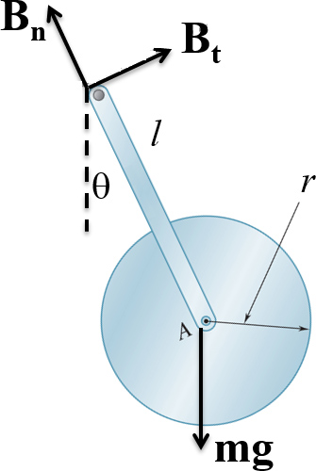
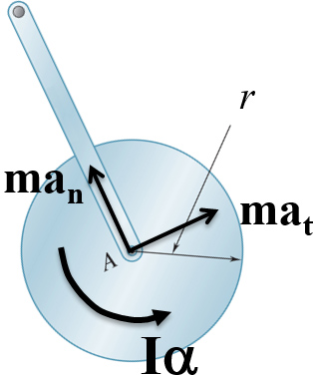
Group Problem Solving 2
Modeling and Analysis:
Draw the FBD and KD of the pendulum (m_{bar} ~ 0).
Determine the equation of motion.
*Note that you could also do this by using the “moment” from a_{t}, and that a _{t} = lα

Slide 26
Group Problem Solving 3
Find I, set up equation of motion using small angle approximation
Determine the natural frequency
Calculate the period

Slide 27
Concept Question 3
In the previous problem, what would be true if the bar was hinged at A instead of welded at A (choose one)?
a) The natural frequency of the oscillation would be larger
b) The natural frequency of the oscillation would be larger
c) The natural frequencies of the two systems would be the same

Slide 28
Concept Question 4
In the previous problem, what would be true if the bar was hinged at A instead of welded at A (choose one)?
a) The natural frequency of the oscillation would be larger
b) Answer: The natural frequency of the oscillation would be larger
c) The natural frequencies of the two systems would be the same

Slide 29
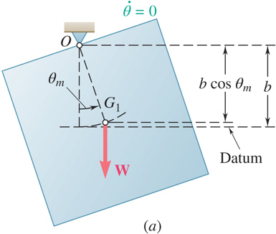
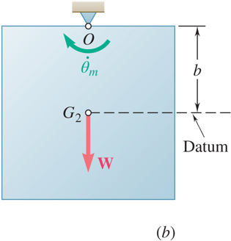
Applying the Principle of Conservation of Energy
Resultant force on a mass in simple harmonic motion is conservative - total energy is conserved.
Consider simple harmonic motion of the square plate,

Slide 30
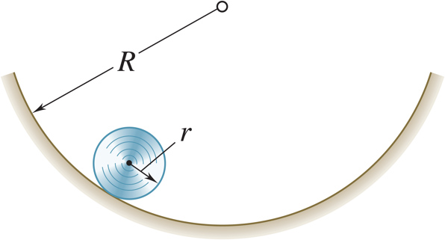
Sample Problem 19.4 1
Strategy:
Apply the principle of conservation of energy between the positions of maximum and minimum potential energy.
Solve the energy equation for the natural frequency of the oscillations.
Determine the period of small oscillations of a cylinder which rolls without slipping inside a curved surface.

Slide 31
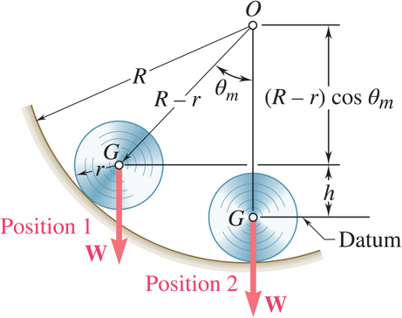
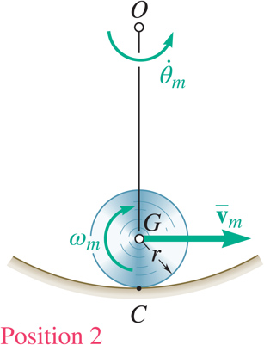
Sample Problem 19.4 2
Modeling and Analysis:
Apply the principle of conservation of energy between the positions of maximum and minimum potential energy.

Slide 32
Sample Problem 19.4 3
Solve the energy equation for the natural frequency of the oscillations.

Slide 33
Sample Problem 19.4 4
Reflect and Think:
This answer makes sense, because as the radius R increases, the period also increases. In the limit, as R goes to infinity, the period also goes to infinity, that is, the system would not oscillate. This is the case of a cylinder on a horizontal surface. The
small angle approximation,
is often used
in problems like this one.

Slide 34
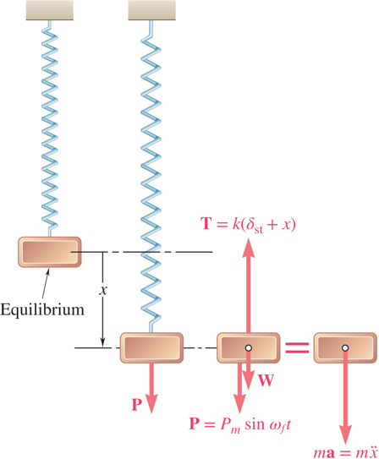
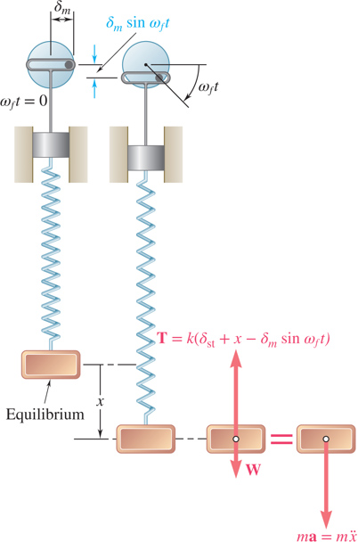
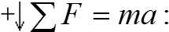
Forced Vibrations 1
Forced vibrations - Occur when a system is subjected to a periodic force or a periodic displacement of a support.
forced frequency

Slide 35
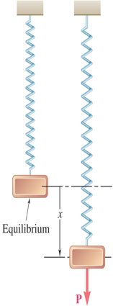
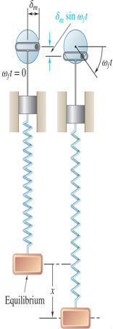
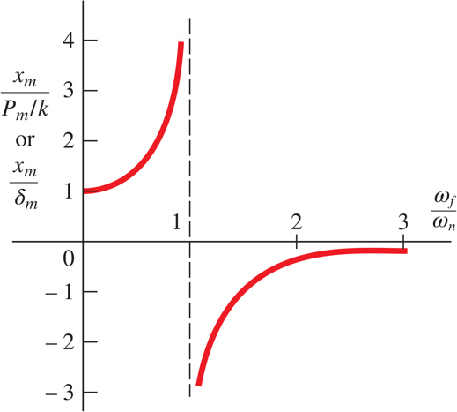
Forced Vibrations 2
Substituting particular solution into governing equation,
forcing input is in
resonance with the system.

Slide 36
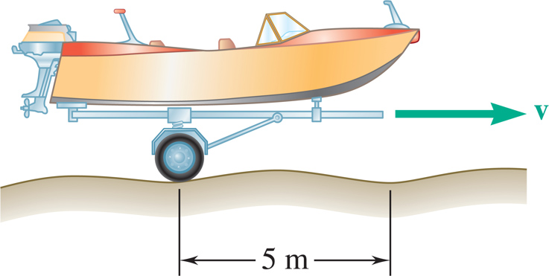
Concept Question 5
A small trailer and its load have a total mass m. The trailer can be modeled as a spring with constant k. It is pulled over a road, the surface of which can be approximated by a sine curve with an amplitude of 40 mm and a wavelength of 5 m. Maximum vibration amplitude occur at 35 km/hr. What happens if the driver speeds up to 50 km/hr?
a) The vibration amplitude remains the same.
b) The vibration amplitude would increase.
c) The vibration amplitude would decrease.

Slide 37
Concept Question 6
A small trailer and its load have a total mass m. The trailer can be modeled as a spring with constant k. It is pulled over a road, the surface of which can be approximated by a sine curve with an amplitude of 40 mm and a wavelength of 5 m. Maximum vibration amplitude occur at 35 km/hr. What happens if the driver speeds up to 50 km/hr?
a) The vibration amplitude remains the same.
b) The vibration amplitude would increase.
c) Answer: The vibration amplitude would decrease.

Slide 38

Sample Problem 19.5 1
Strategy:
The resonant frequency is equal to the natural frequency of the system.
Evaluate the magnitude of the periodic force due to the motor unbalance. Determine the vibration amplitude from the frequency ratio at 1200 rpm.
A motor of mass 200 kg is supported by four springs, each having a constant 150 kN/m. The unbalance of the motor is equivalent to a mass of 30 g located 150 mm from the axis of rotation.
Determine a) speed in rpm at which resonance will occur, and b) amplitude of the vibration at 1200 rpm.

Slide 39
Sample Problem 19.5 2
Modeling and Analysis:
The resonant frequency is equal to the natural frequency of the system.
Resonance speed = 523 rpm

Slide 40
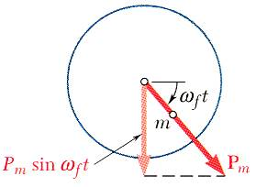
Sample Problem 19.5 3
Evaluate the magnitude of the periodic force due to the motor unbalance. Determine the vibration amplitude from the frequency ratio at 1200 rpm.
m = 200 kg
k = 600,000 N/m
x_{m} = 0.0278 mm (out of phase)

Slide 41
Sample Problem 19.5 4
Reflect and Think:
In problems involving an unbalanced mass, the result of the imbalance is equivalent to an applied force of P_{m} = mrω². In this problem, since ω_{f} > ω_{n}, the vibration is 180° out of phase with the force due to the unbalance of the rotor. For example, when the unbalanced mass is directly below the axis of rotation, the position of the motor is x_{m} = 0.0278 mm above the position of equilibrium.

Slide 42
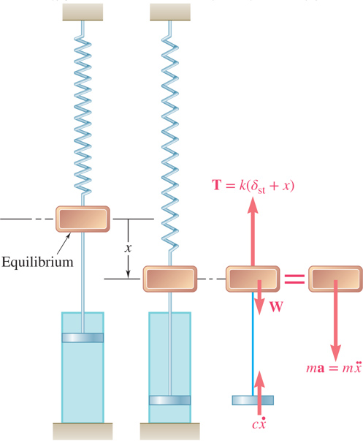
Damped Free Vibrations 1
All vibrations are damped to some degree by forces due to dry friction, fluid friction, or internal friction.
With viscous damping due to fluid friction,
Substituting
and dividing through by
yields the characteristic equation,
Define the critical damping coefficient such that

Slide 43
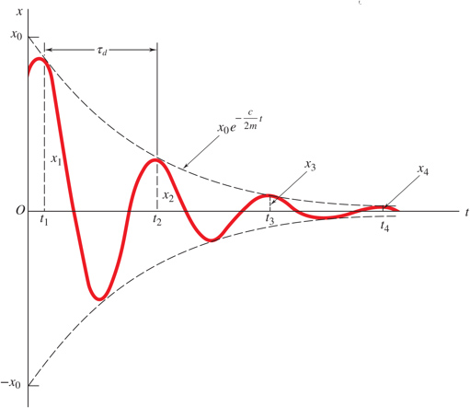
Damped Free Vibrations 2
Characteristic equation,
critical damping coefficient
Heavy damping: c > c_{c}
- negative roots
- nonvibratory motion
Critical damping: c = c_{c}
- double roots
- nonvibratory motion
Light damping: c < c_{c}
damped frequency

Slide 44
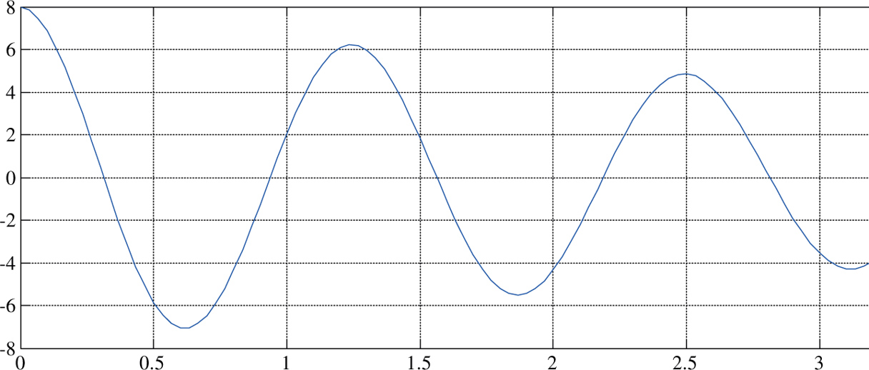
Concept Question 7
The graph above represents an oscillation that is…
a) Heavily damped
b) critically damped
c) lightly damped

Slide 45
Concept Question 8
The graph above represents an oscillation that is…
a) Heavily damped
b) critically damped
c) lightly damped

Slide 46
Concept Question 9
The period for the oscillation above is approximately…
a) 1.25 seconds
b) 2.5 Hz
c) 0.6 seconds
Estimate the phase shift for the oscillation
Zero

Slide 47
Concept Question 10
The period for the oscillation above is approximately…
a) 1.25 seconds
b) 2.5 Hz
c) 0.6 seconds
Estimate the phase shift for the oscillation
Zero

Slide 48

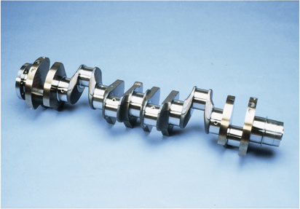
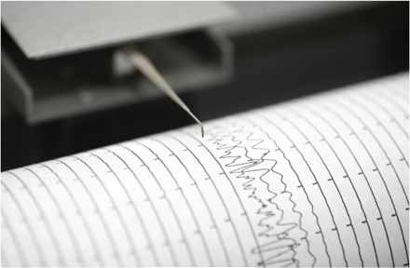
Forced vibrations can be caused by a test machine, by rotating machinery, and by earthquakes. Suspension systems, shock absorbers, and other energy-dissipating devices can help to dampen the resulting vibrations.

Slide 49
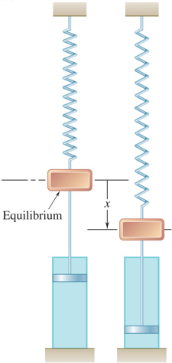
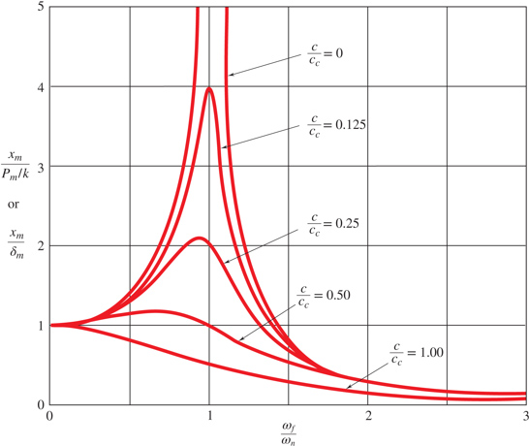
Damped Forced Vibrations
magnification factor
phase difference between forcing and steady state response

Slide 50
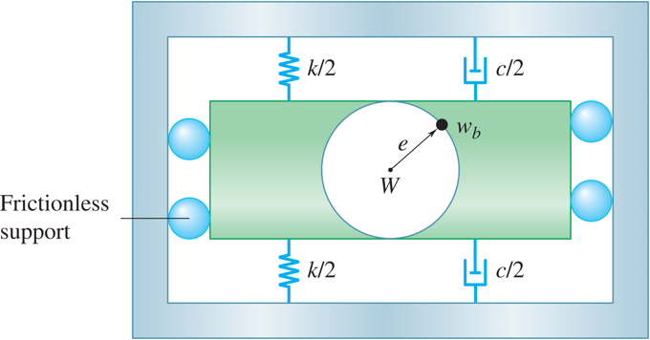
Group Problem Solving 4
Strategy:
Determine the system natural frequency, damping constant, and the unbalanced force.
Determine the steady state response and the magnitude of the motion.
A simplified model of a washing machine is shown. A bundle of wet clothes forms a mass m_{b} of 10 kg in the machine and causes a rotating unbalance. The rotating mass is 20 kg (including m_{b}) and the radius of the washer basket e is 25 cm. Knowing the washer has an equivalent spring constant k = 1000 N/m and damping ratio z = c/c_{c} = 0.05 and during the spin cycle the drum rotates at 250 rpm, determine the amplitude of the motion.

Slide 51
Group Problem Solving 5
Modeling and Analysis:
Given: m= 20 kg, k = 1000 N/m,
e = 25 cm, m_{b}= 10 kg
Find: x_{m}
Calculate the forced circular frequency and the natural circular frequency
Calculate the critical damping constant c_{c} and the damping constant c

Slide 52
Group Problem Solving 6
Calculate the unbalanced force caused by the wet clothes
Use Equation 19.52 to determine x_{m}

Slide 53
Concept Question 11
The following parameters were found in the previous problem:
What would happen to the
amplitude
if the forcing
frequency
was cut in half?
a) The vibration amplitude remains the same.
b) The vibration amplitude would increase.
c) The vibration amplitude would decrease.

Slide 54
Concept Question 12
The following parameters were found in the previous problem:
What would happen to the
amplitude
if the forcing
frequency
was cut in half?
a) The vibration amplitude remains the same.
b) Answer: The vibration amplitude would increase.
c) The vibration amplitude would decrease.

Slide 55
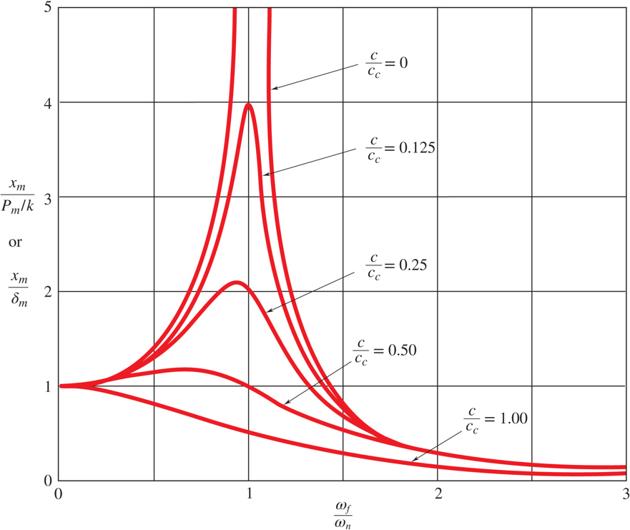
Concept Question 13
Case 1
Case 2

Slide 56
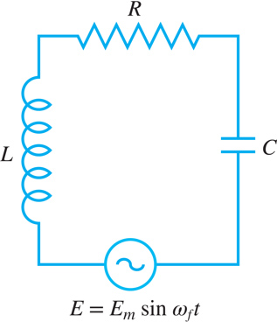
Electrical Analogues 1
Consider an electrical circuit consisting of an inductor, resistor and capacitor with a source of alternating voltage,
Oscillations of the electrical system are analogous to damped forced vibrations of a mechanical system.

Slide 57
Electrical Analogues 2
Table 19.2
Characteristics of a mechanical System and of its Electrical Analog
Blank | Mechanical System | Blank | Electrical Circuit
m | mass | L | Inductance
c | Coefficient of viscous damping | R | Resistance
k | Spring constant | l/C | Reciprocal of capacitance
x | Displacement | q | Charge
v | Velocity | l | Current
P | Applied force | E | Applied voltage

Slide 58
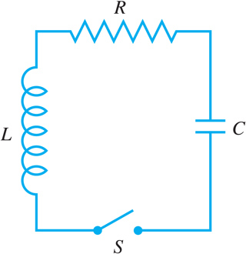

Electrical Analogues 3
The analogy between electrical and mechanical systems also applies to transient as well as steady-state oscillations.
With a charge q = q₀ on the capacitor, closing the switch is analogous to releasing the mass of the mechanical system with no initial velocity at x = x₀.
If the circuit includes a battery with constant voltage E, closing the switch is analogous to suddenly applying a force of constant magnitude P to the mass of the mechanical system.

Slide 59


Electrical Analogues 4
The electrical system analogy provides a means of experimentally determining the characteristics of a given mechanical system.
For the mechanical system,
For the electrical system,
The governing equations are equivalent. The characteristics of the vibrations of the mechanical system may be inferred from the oscillations of the electrical system.

Slide 60
End of Chapter 19

